Slide 1
SE Tools and Practices
(SENG4144)
Arba Minch University
Institute of Technology
Faculty of Computing & Software Engineering
Addisu M. (Asst. Prof)
G4 it - Summer
Notes:
https://www.scribd.com/document/576561194/Chapter-1-new

Slide 2
Chapter 4
SOFTWARE REQUIREMENTS ANALYSIS

Slide 3
Introduction to Software Requirements Analysis
Software requirements are specifications of what a software system should do and how it should perform.
  provide a clear and detailed description of the system to be developed, serving as a contract between clients and developers.
  Requirements are gathered at the start of the project but can evolve with changing project needs.
Software Requirements Analysis (SRA) – process of defining, documenting, and managing the requirements for a SW system.
  critical phase in the software development lifecycle (SDLC)
  involves gathering, analyzing, and documenting needs & expectations of stakeholders to ensure final product meets their requirements.
  involves understanding what users need from the system and translating those needs into clear, actionable requirements.
SDLC – a structured process for developing software applns.
  It consists of distinct phases that guide the project from conception to deployment and maintenance.

Slide 4
Introduction to Software Requirements Analysis
Phases of SDLC:
  Planning: Define the scope, goals, and feasibility of the project.
  Requirements Analysis: Gather and analyze requirements from stakeholders.
  Design: Create architectural and design specifns based on requirements.
  Implementation: Develop the SW according to design specifns.
  Testing: Verify that SW meets requirements and is free of defects.
  Deployment: Release SW to users and ensure it is operational.
  Maintenance: Provide ongoing support and updates as needed.
Models of SDLC:
  Waterfall Model
  Agile Model
  Spiral Model

Slide 5
Software Requirements Analysis
Importance of Requirements Analysis in SDLC
  Foundation for Development:
    Requirements analysis sets the groundwork for design, development, and testing phases.
  Stakeholder Alignment:
    It ensures that the needs of all stakeholders (users, clients, developers) are considered and aligned.
    Facilitates better collaboration and reduces conflicts.
  Risk Mitigation:
    By identifying potential issues & ambiguities early, requirements analysis helps mitigate risks and manage expectations.
  Cost and Time Efficiency:
    Well-defined requirements can lead to fewer changes and reworks later in the project, saving time and resources.

Slide 6
Software Requirements Analysis
Importance of Requirements Analysis in SDLC
  Improved Communication: it facilitates effective commn b/n stakeholders, developers, and other team members
    Clear requirements help avoid misunderstandings and miscommunications among stakeholders
  Better Quality Software: When requirements are well-defined and documented, it becomes easier to design, develop, and test the SW
    This leads to a higher quality product with fewer defects
  Increased Customer Satisfaction: When SW meets the needs of the users, it leads to increased customer satisfaction and loyalty
  Improved Project Management: A clear understanding of requirements helps to create a realistic project plan and track progress effectively

Slide 7
Types of Requirements
Functional Requirements:
  Describe what the system should do – the functions it must perform.
  include features, use cases, and user interactions
  Examples:
    User authentication and authorization
    Data processing and manipulation
    Reporting and analytics functions

Slide 8
Types of Requirements
Non-functional Requirements:
  define quality attributes, system performance, and constraints.
  describe how the system performs its functions – the performance characteristics.
  Examples:
    Performance metrics (e.g., response time, throughput).
    Security requirements (e.g., data encryption, access controls).
    Usability (e.g., Ease of use, UI design standards, accessibility).
    Reliability (e.g., uptime requirements, fault tolerance).
    Scalability (e.g., Ability to handle growth)

Slide 9
Levels of Requirements
Software requirements are typically categorized into three main levels:
  business requirements: outline the high-level goals of the organization;
  user requirements: detailing what users need from the system; and
  functional requirements: specifying the system's functionalities to meet those needs.
Understanding these levels is crucial for effective software development and project management

Slide 10
Levels of Requirements
1. Business Requirements
High-level requirements that describe what the organization aims to achieve through the software.
Typically derived from business owners or stakeholders
Examples
Increase revenue or customer reach
Reduce operational costs or errors
Improve customer service and satisfaction

Slide 11
Levels of Requirements
2. User Requirements
Requirements that specify what users need to accomplish with the system.
Characteristics:
Often articulated through use cases or user stories.
Focus on user tasks and interactions with the system.
Examples:
Ability to generate reports.
Access to order history and status.
Management of customer databases.

Slide 12
Levels of Requirements
3. Functional Requirements
Detailed specifications of the functions and features that the software must provide.
To ensure that the system meets user needs and business objectives.
Characteristics:
Describe system behavior under specific conditions.
Must be documented in Software Requirements Specification (SRS)
Examples:
The system shall allow users to create, read, update, and delete records (CRUD operations).
The system shall validate user credentials during login.

Slide 13
Stakeholder Engagement
Stakeholders – individuals or groups who have an interest in the outcome of a project.
  Identifying stakeholders is crucial for ensuring that all relevant perspectives are considered during the requirements analysis process.
Types of Stakeholders:
  Primary Stakeholders: Directly affected by the project (e.g., end-users, customers).
  Secondary Stakeholders: Indirectly affected or have an interest in the project (e.g., management, support teams).
  Key Stakeholders: Have significant influence or authority over the project (e.g., project sponsors, executives).
Techniques for Identifying Stakeholders:
  Stakeholder Mapping: Visualizing relationships and influence levels.
  Brainstorming Sessions: Collaboratively identifying stakeholders with team
  Reviewing Existing Documentation: Analyzing previous project documents to identify involved parties.

Slide 14
Stakeholder Engagement
Effective manag’t of stakeholder expectations is vital for project success, ensuring that all parties are aligned and satisfied with the project outcomes.
Strategies for Managing Expectations:
  Regular Communication: Keep stakeholders informed of progress, changes, and challenges through updates, meetings, and reports.
  Setting Realistic Goals: Clearly define what can and cannot be achieved within the project scope and timeline.
  Involving Stakeholders in Decision-Making: Engage key stakeholders in discussions about requirements and priorities to foster a sense of ownership and commitment.
  Feedback Mechanisms: Establish channels for ongoing feedback to address concerns and adjust expectations as needed.

Slide 15
Techniques for Gathering Requirements
Interviews:
  One-on-one conversations with stakeholders to elicit detailed information about their needs and expectations.
  Types of Interviews:
    Structured: Predefined questions with a fixed format.
    Semi-structured: A mix of predefined and open-ended questions.
    Unstructured: Free-form discussions that allow for exploration of topics.
  Benefits: Provides detailed insights, clarifies ambiguous requirements, and builds rapport with stakeholders.
  Best Practices:
    Prepare questions in advance.
    Actively listen and take notes.
    Follow up on unclear points for deeper understanding.

Slide 16
Techniques for Gathering Requirements
Surveys and Questionnaires:
  Tools for collecting information from a larger group of stakeholders efficiently.
  Types: Open-ended, close-ended, or a mix of both.
  Benefits:
    Cost-effective and can reach a broad audience.
    Can be anonymous, encouraging honest feedback.
  Best Practices:
    Keep questions clear and concise.
    Use a mix of closed and open-ended questions.
    Ensure the survey is easy to access and complete.

Slide 17
Techniques for Gathering Requirements
Workshops:
  Collaborative sessions where stakeholders come together to discuss requirements and brainstorm ideas.
  Types of Workshops:
    Requirements elicitation workshops.
    Prioritization workshops to determine the most critical requirements.
  Best Practices:
    Set a clear agenda and objectives.
    Use facilitators to guide discussions.
    Encourage participation from all stakeholders.

Slide 18
Techniques for Gathering Requirements
Observation:
  Watching users interact with a current system or workflow to identify needs and pain points.
Document Analysis:
  Reviewing existing documentation to identify requirements or constraints.
Use Cases and Scenarios:
  Defining specific examples of how users will interact with the system.
Brainstorming:
  Generating ideas collectively to uncover requirements.
Focus Groups:
  Discussing ideas and feedback with a group of users or stakeholders.
Notes:
Brainstorming is a creative problem-solving technique used to generate ideas, solutions, or insights through collaborative thinking. It encourages participants to think freely, share ideas openly, and build on each other's contributions without criticism or judgment during the ideation phase.

Slide 19
Requirements Specification and Documentation
Writing Clear and Concise Requirements
  Importance of Clarity: Clear and concise requirements reduce ambiguity, ensuring all stakeholders have a common understanding of what is needed.
  Characteristics of Good Requirements:
    Specific: Clearly defined and unambiguous.
    Measurable: Capable of being validated through testing or review.
    Achievable: Realistic and feasible within project constraints.
    Relevant: Directly related to the project goals and stakeholder needs.
    Time-bound: Associated with a timeline for completion, if applicable.

Slide 20
Requirements Specification and Documentation
Writing Clear and Concise Requirements
  Techniques for Writing Requirements:
    Use Simple Language: Avoid technical jargon unless essential to the audience.
    Active Voice: Use active voice to clarify who is responsible for actions (e.g., "The system shall allow users to log in").
    Consistent Terminology: Use consistent terms throughout the documentation to prevent confusion.
    Numbering and Formatting: Organize requirements logically with numbering for easy reference.

Slide 21
Requirements Specification and Documentation
Formats for Requirements Documentation
Requirements Specification Document (RSD):
  A comprehensive document that outlines all functional and non-functional requirements for a system.
  Contents:
    Introduction and purpose.
    Scope of the project.
    Detailed requirements (both functional and non-functional).
    Use cases and user stories.
    Assumptions and constraints.
  Purpose: Serves as a reference for stakeholders, developers, and testers throughout the project lifecycle.

Slide 22
Requirements Specification and Documentation
Formats for Requirements Documentation
User Requirements Document (URD):
  A document that focuses specifically on the needs and expectations of end-users.
  Contents:
    User profiles and personas.
    User requirements, including user stories and scenarios.
    Non-functional requirements from the user's perspective (e.g., usability, performance).
  Purpose: Ensures that the system design aligns closely with user needs and expectations.

Slide 23
Requirements Specification and Documentation
Best Practices in Documentation
  Keep Documentation Up-to-Date: Regularly review and revise documentation to reflect changes in requirements or stakeholder feedback.
  Use Visual Aids: Incorporate diagrams, flowcharts, and models to complement textual descriptions and enhance understanding.
  Version Control: Implement a version control system to track changes and maintain a history of document revisions.
  Stakeholder Review: Involve stakeholders in the review process to validate requirements and ensure alignment with their needs.
  Maintain an Index or Glossary: Include an index or glossary of terms to help users navigate the documentation easily.

Slide 24
Requirements Modeling
Unified Modeling Language (UML) – a standardized visual language used to specify, visualize, develop, and document the artifacts of software systems.
Purpose of Modeling:
  Clarifies requirements and system functionality.
  Facilitates communication among stakeholders.
  Provides a blueprint for development.
Key UML Diagrams:
  Use Case Diagrams: Represent user interactions with the system.
  Class Diagrams: Show the structure of the system by illustrating its classes and relationships.
  Sequence Diagrams: Detail how objects interact in a particular scenario over time.
  Activity Diagrams: Model the workflow of a system or process.

Slide 25
Requirements Modeling
Benefits of Using UML:
  Standardization: Enhances understanding across different teams and stakeholders.
  Flexibility: Applicable to various types of software development methodologies.
  Visual Representation: Makes complex systems easier to comprehend.

Slide 26
Requirements Modeling
Use Case Diagram: visually represents how users (actors) interact with a system to achieve specific goals.
  part of UML and focuses on system functionality from the user's perspective.
Components of Use Case Diagrams:
  Actors: Entities (users, systems) interacting with the system.
    Depicted as stick figures.
  Use Cases: Specific functionalities or services provided by the system (e.g., login, search).
    Shown as ovals
  System Boundary: Defines the scope of the system being modeled.
    Represented as a rectangle enclosing the use cases.

Slide 27
Requirements Modeling
Components of Use Case Diagrams:
  Relationships:
    Associations: Lines connecting actors to use cases.
    Generalization: Indicates an inheritance relationship between actors.
    Include: Represents functionality shared across multiple use cases (e.g., "Authenticate User" included in "Place Order").
    Extend: Represents optional or conditional functionality (e.g., "Apply Discount" extending "Make Payment").
Best Practices:
  Identify all relevant actors and their goals before creating the diagram.
  Keep the diagram simple, focusing on high-level interactions.
  Use clear and descriptive names for use cases.

Slide 28
Requirements Modeling
Example: Online Shopping System
  Actors:
    Customer
    Admin
    Guest
  Relationships:
    Include: "Authenticate User" is included in "Place Order."
    Extend: "Apply Discount" extends "Make Payment."
  Use Cases:
    Register Account (for Guest)
    Login (Customer and Admin)
    Browse Products (for Customer and Guest)
    Search Products (for Customer and Guest)
    Add to Cart (for Customer)
    View Cart (for Customer)
    Make Payment (for Customer)
    Manage Products (for Admin)
    Manage Orders (for Admin)
    Delete Account (for Customer)

Slide 29
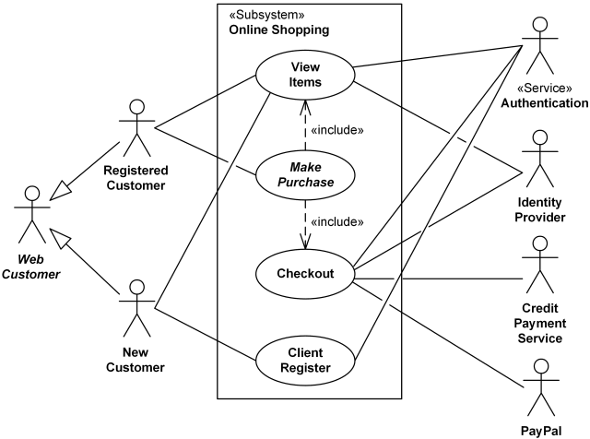
Requirements Modeling
Example: Online Shopping System

Slide 30
Requirements Modeling
Class Diagrams: used to represent the static structure of a system by depicting the system's classes, their attributes, methods, and the relationships between the classes.
Components:
  Classes: Represented by rectangles containing the class name, attributes, and methods.
  Relationships: Lines connecting classes represent associations, while arrows can indicate inheritance or dependencies.

Slide 31
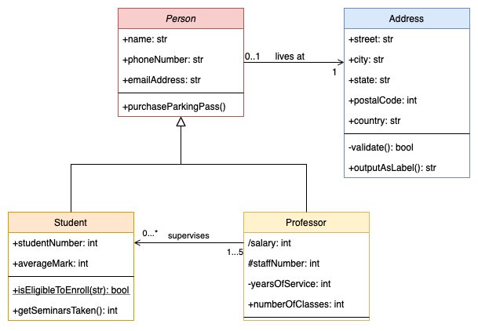
Requirements Modeling
Class Diagrams

Slide 32
Requirements Modeling
Sequence Diagrams: represent the interaction between objects over time.
  They show how objects interact in a particular scenario of a use case.
Components:
  Lifelines: Vertical dashed lines representing the lifespan of an object.
  Messages: Horizontal arrows indicating interactions between objects.
  Activation Bars: Thin rectangles on lifelines indicating the period an object is active.

Slide 33
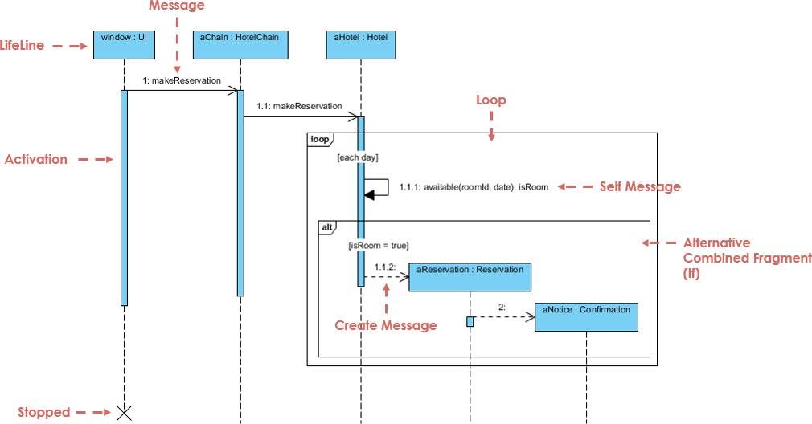
Requirements Modeling
Sequence Diagrams

Slide 34
Requirements Modeling
Activity Diagrams: illustrate the dynamic aspects of a system by showing the flow of control or decision points from one activity to another.
  similar to flowcharts.
Components:
  Activities: Represented by rounded rectangles.
  Transitions: Arrows indicating the flow from one activity to another.
  Decision Points: Diamonds representing branching paths based on conditions.

Slide 35
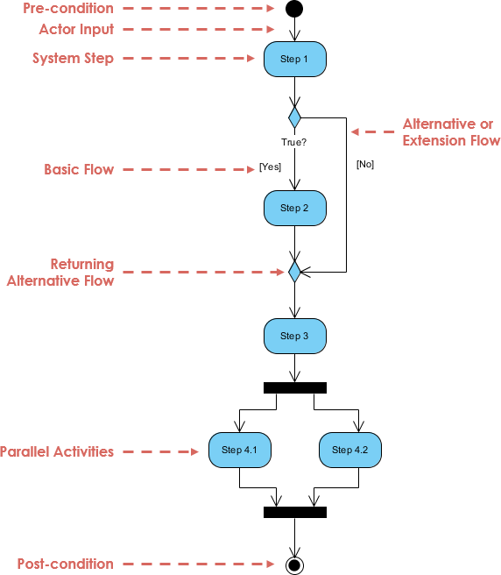
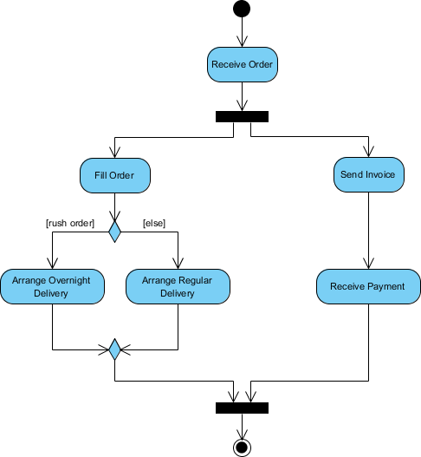
Requirements Modeling
Activity Diagrams

Slide 36
Requirements Modeling
Component Diagram: illustrates the high-level structure of a system, showing the system's components and how they are related.
Purpose: To model the physical aspects of a system, including software components and their interfaces.
Components:
  Components
  Interfaces
  Relationships

Slide 37
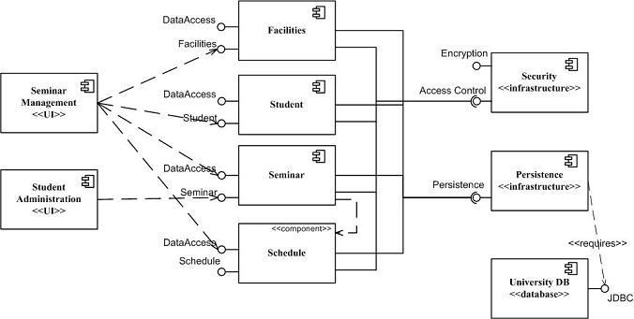
Requirements Modeling
Component Diagram

Slide 38
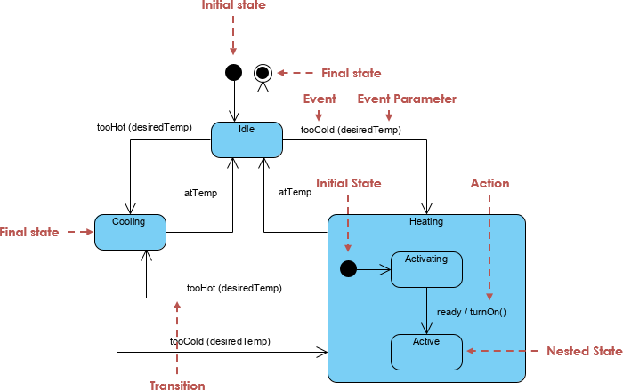
Requirements Modeling
State Diagram: shows the states of an object and the transitions between those states, triggered by events.
Purpose: To model the states and transitions of system objects.
Components:
  States
  Transitions
  Events
  Actions

Slide 39
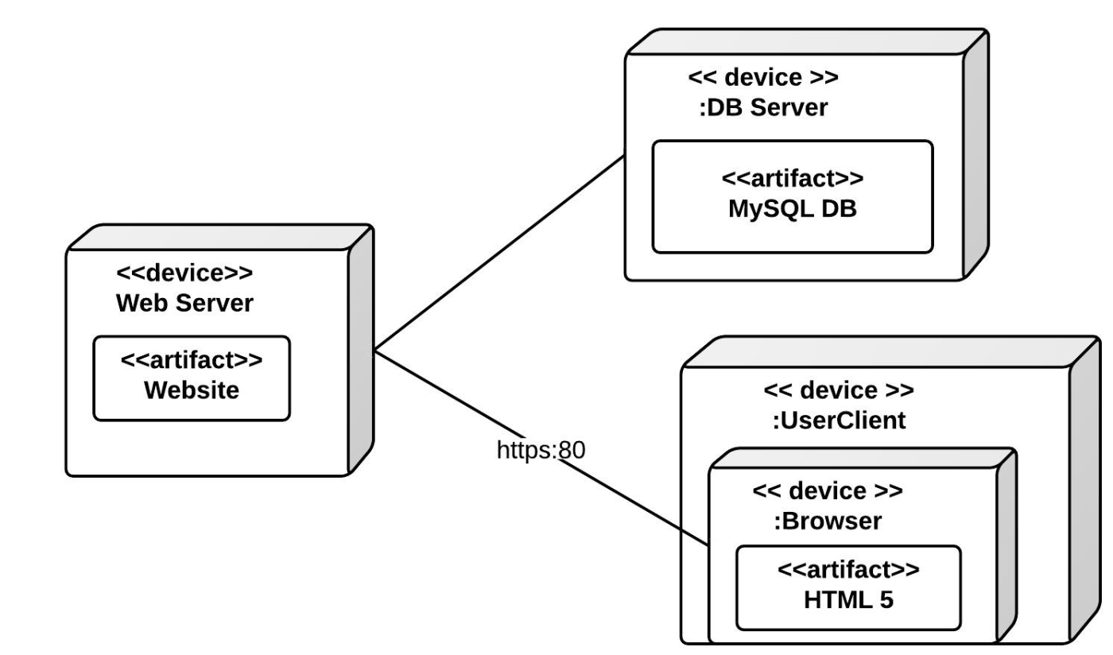
Requirements Modeling
Deployment Diagram: represents the physical deployment of artifacts on nodes, such as software applns on hardware.
Purpose: To model the execution architecture of a system.
Components:
  Nodes
  Artifacts
  Relationships

Slide 40
Requirements Modeling
Entity-Relationship Diagrams (ERDs)
ERDs are essential tools in database design and modeling. They provide a visual representation of data entities, their attributes, and the relationships between them.
Components of ERDs:
  Entities: Represent objects, concepts, or things in the database that have a distinct existence (e.g., User, Product).
    Depicted as rectangles.
    Types:
      Strong Entities: Can exist independently (e.g., "Employee").
      Weak Entities: Depend on a strong entity and lack a unique identifier (e.g., "Dependent").

Slide 41
Requirements Modeling
Entity-Relationship Diagrams (ERDs)
Components of ERDs:
  Attributes: Represent properties or details about entities (e.g., User ID, Product Name).
    Depicted as ellipses connected to entities or relationships.
    Types:
      Simple Attributes: Cannot be divided further (e.g., "Name").
      Composite Attributes: Can be divided into smaller components (e.g., "FullName" → "FirstName" + "LastName").
      Derived Attributes: Calculated from other attributes (e.g., "Age" derived from "Date of Birth").
      Multivalued Attributes: Have multiple values (e.g., "PhoneNumbers").

Slide 42
Requirements Modeling
Entity-Relationship Diagrams (ERDs)
Components of ERDs:
  Relationships: Connections between entities that define how they interact (e.g., one-to-many, many-to-many).
    Depicted as diamonds.
    Types:
      One-to-One (1:1): One instance of an entity relates to one instance of another entity (e.g., "Person - Passport").
      One-to-Many (1:N): One entity relates to multiple instances of another (e.g., "Department - Employees").
      Many-to-Many (M:N): Multiple entities relate to multiple instances of another (e.g., "Students - Courses")

Slide 43
Requirements Modeling
Entity-Relationship Diagrams (ERDs)
Components of ERDs:
  Primary Key (PK): A unique attribute or combination of attributes used to identify an entity instance.
  Cardinality: Defines the number of instances of an entity that can be associated with another.
    Common notations include:
      (1,1): Exactly one.
      (0,N): Zero or many.
      (1,N): At least one, up to many.

Slide 44
Requirements Modeling
Example: Library Management System
  Entities:
    Book:
      Attributes: BookID (PK), Title, Author, ISBN
    Member:
      Attributes: MemberID (PK), Name, Email
    Loan (Relationship):
      Attributes: LoanDate, ReturnDate
  Relationships:
    Book and Loan: One-to-Many (A book can be loaned multiple times).
    Member and Loan: One-to-Many (A member can borrow multiple books).

Slide 45
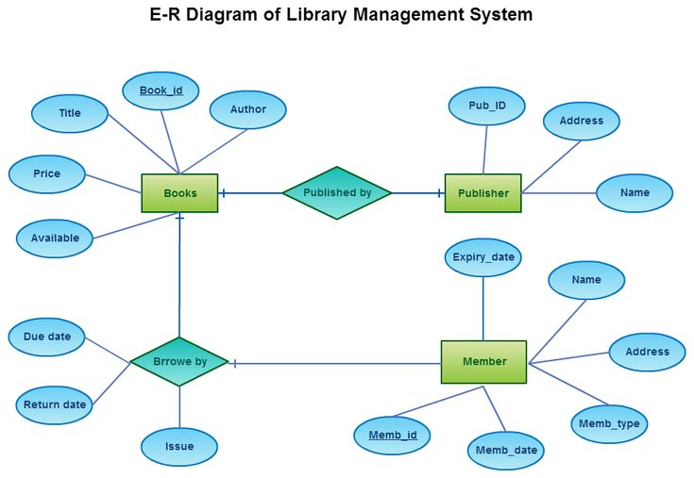
Requirements Modeling
Example: Library Management System

Slide 46
Tools for Requirements Analysis
Requirements Management Tools:
JIRA, Trello, IBM Engineering Requirements Management DOORS.
Modeling Tools:
UML tools (e.g., Lucidchart, Visual Paradigm).
Prototyping Tools:
Axure, Balsamiq, Figma.
Collaboration Tools:
Confluence, Microsoft Teams, Slack.

Slide 47
Tools for Requirements Analysis
Requirements Management Tools
JIRA: Popular for agile dev’t, strong issue tracking capabilities, customizable workflows.
Trello: Agile-friendly, visually appealing Kanban boards, good for user stories and task management.
IBM Engineering Requirements Management DOORS: Industry-standard for complex systems, robust features but can have a steeper learning curve.
Jama Software: Focuses on systems and safety-critical applications, strong traceability features

Slide 48
Tools for Requirements Analysis
Modeling Tools - UML Tools:
Lucidchart: User-friendly, cloud-based, good for various diagram types (UML, flowcharts, etc.).
Visual Paradigm: Powerful toolset for complex UML diagrams, suitable for larger projects.
Enterprise Architect: Comprehensive tool with a wide range of features, including model-driven development.

Slide 49
Tools for Requirements Analysis
Prototyping Tools
Axure: Professional-grade prototyping, powerful for interactive prototypes and specifications.
Balsamiq: Low-fidelity prototyping, quick and easy to use, ideal for brainstorming and early-stage design.
Figma: Cloud-based, collaborative, excellent for UI/UX design and prototyping, strong for team workflows.
Adobe XD: Focuses on user experience design, good for creating interactive prototypes and design systems.

Slide 50
Tools for Requirements Analysis
Collaboration Tools
Confluence: Wiki-based platform for documentation, knowledge sharing, and team collaboration.
Microsoft Teams: Integrated communication and collaboration hub, with features like chat, video conferencing, and file sharing.
Slack: Real-time communication and collaboration platform, popular for team messaging and file sharing.
Google Workspace (Docs, Sheets, Meet): Suite of tools for document creation, collaboration, and video conferencing.

Slide 51
Any Question
???

